Slide 1
A Glimpse into Type II Diabetes (T2D) at the Gene Expression Level
Zinc Group Presenters
Lucy Chi
Janet ( Jia He ) Zhang
Cindy ( Xiao Yu) Zhang

Slide 2
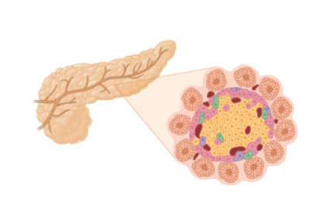
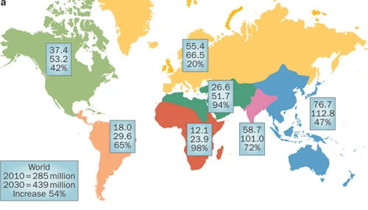

Ideas Emerged!
Well… 439 millions are diagnosed by 2017 (Khan et al. 2020)
Ninth leading cause for mortality
Notes:
https://www.nature.com/articles/nrendo.2011.183
https://www.ncbi.nlm.nih.gov/pmc/articles/PMC7310804/#:~:text=Globally%2C%20an%20estimated%20462%20million,ninth%20leading%20cause%20of%20mortality.

Slide 3

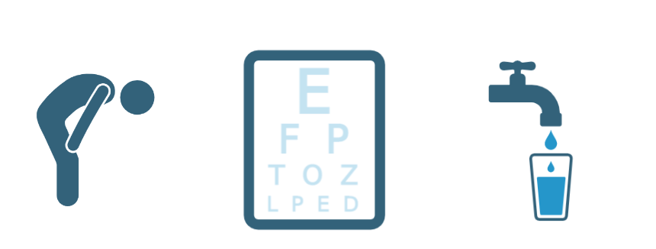
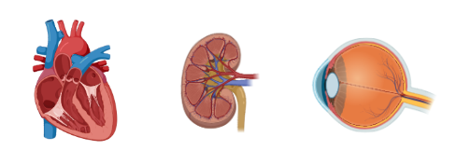
T2D Overview
Type II diabetes is a common disorder characterized by elevated blood sugar due to:
Cells do not respond to insulin
Not enough insulin
Many symptoms
As of now, there is no effective cure
(biorender)
Notes:
https://www.nature.com/articles/s41574-020-0381-5
https://journals.plos.org/plosone/article?id=10.1371/journal.pone.0190993
Sorry took out the sign with an overweight person on the scale. T2D normally causes weight loss not weight gain.

Slide 4
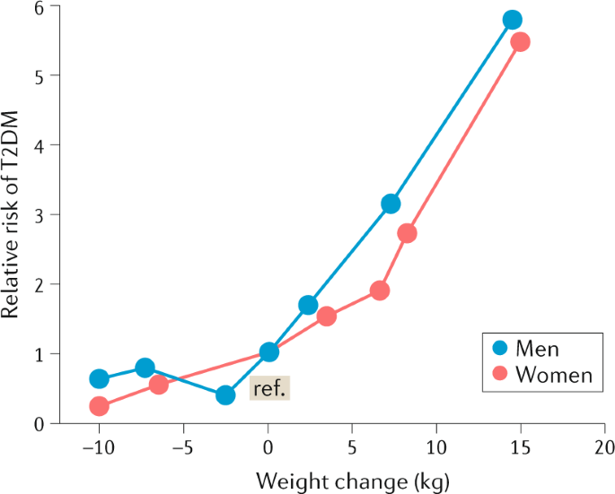
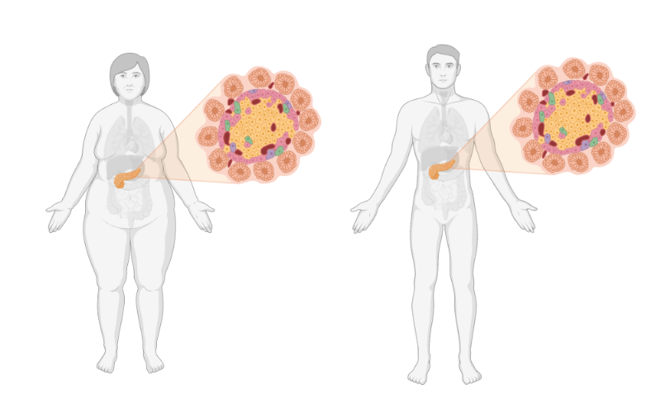
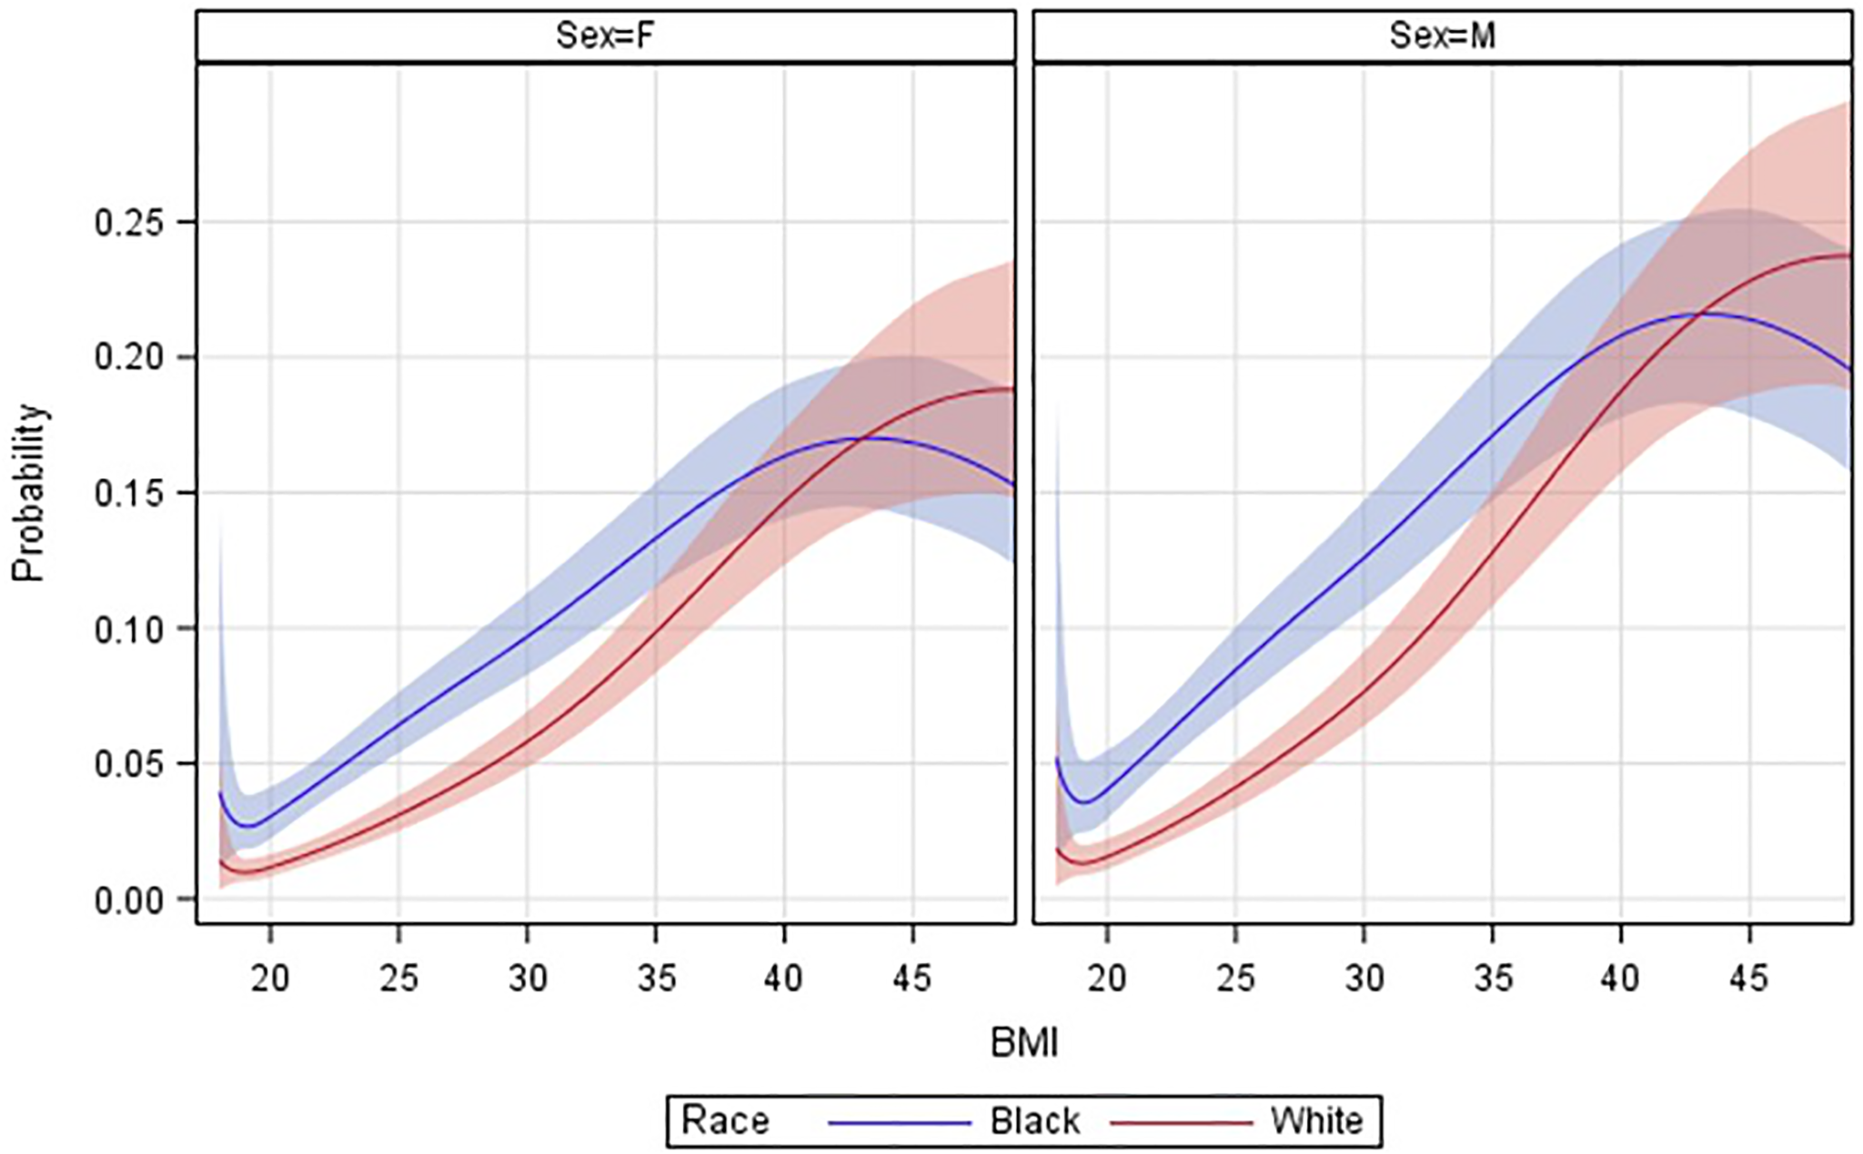
Obesity in T2D
BMI>30
BMI<30
(biorender)
Notes:
T2D is thought to be associated with high body fat percentage
Obese creates metabolic complications associated with T2D

Slide 5
Non-Obesity in T2D
Non-obese T2D patients have been increasing (e.g. Asia)
Genetic factors may be the driven factors in this population. Mechanisms unknown.
BMI>30
BMI<30
(biorender)

Slide 6

Biological Question
Does obesity contribute to gene expression change for T2D patients? Is there a difference in the gene expression between T2D patients who are obese and non-obese?

Slide 7
Hypothesis
T2D and obesity are associated with differential gene expression. Moreover, the non-obese and obese individuals with T2D are expected to have different gene expression due to the different mechanisms mentioned earlier

Slide 8
Aims
Aim1: perform linear regression to assess the effect of T2D and/or BMI on differential gene expression
Aim2: perform gene set enrichment analysis with Reactome, PID, ImmuneSigDB, Reactome and KEGG databases for differentially expressed genes

Slide 9
Dataset Described by 2 Studies
77 samples
GSE41762: Microarray RNA
77 samples are available
HOWEVER, samples were collected from two separate experiments
 | Non-Obese | Obese
Healthy | 53 | 4
T2D | 14 | 6
48 samples
(Experiment 1)
29 samples
(Experiment 2)
 | Non-Obese | Obese
Healthy | 32 | 0
T2D | 8 | 2
 | Non-Obese | Obese
Healthy | 15 | 4
T2D | 6 | 4
Mahdi et al., 2012
Tang et al., 2014

Slide 10
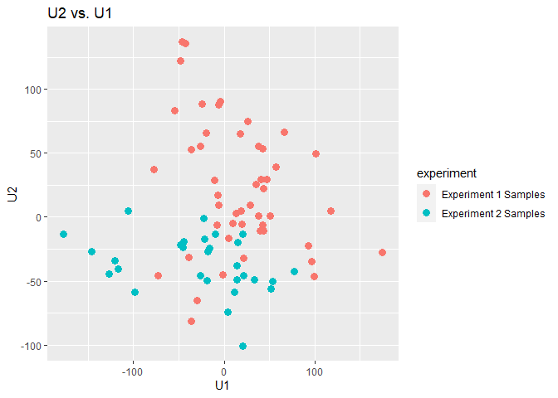
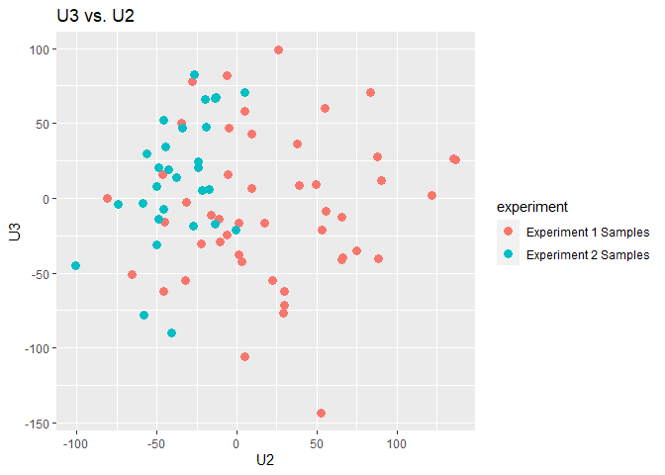
Justifiable to Merge Data from the Two Experiments ?
Insert image

Slide 11
Two Approaches for Handling Batch Effects
Merge Data:
ComBat : Sample sizes 48 vs. 29, overcorrection and other confounders
Analyze Data Separately

Slide 12
Separate Analysis on DataSets from the Two Experiments
Expression data for sample 1:48 (experiment 1) were used to evaluate T2D effect on differential gene expression
Expression data for sample 49:77 (experiment 2) were used to evaluate the effect of T2D, BMI and their interaction on gene expression

Slide 13
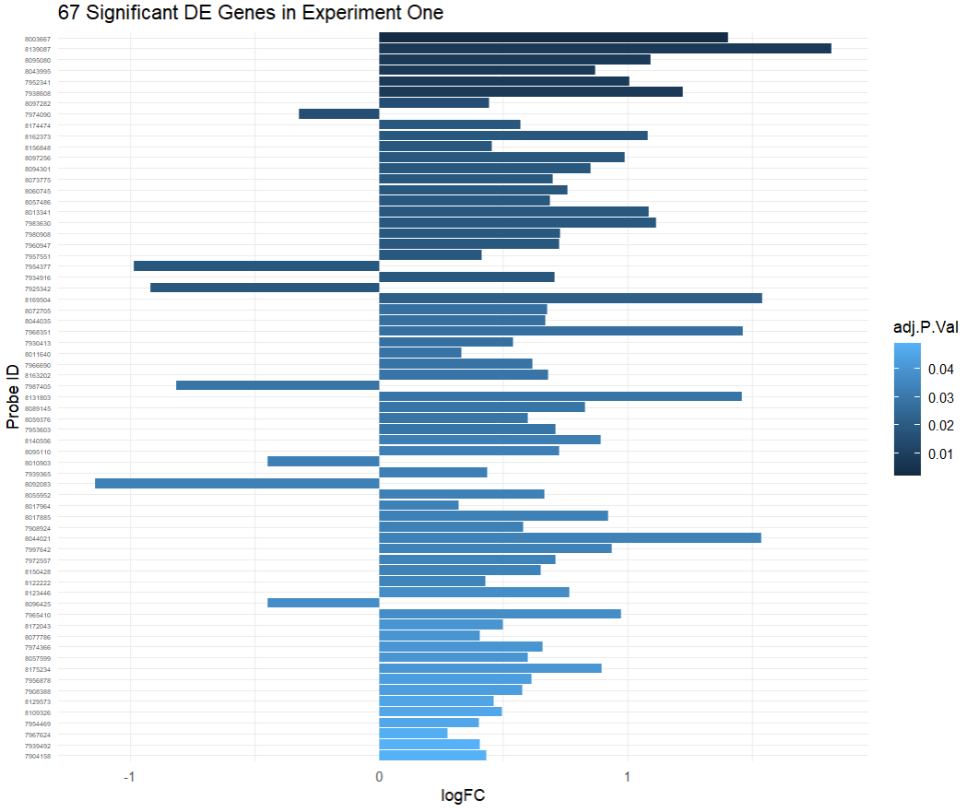

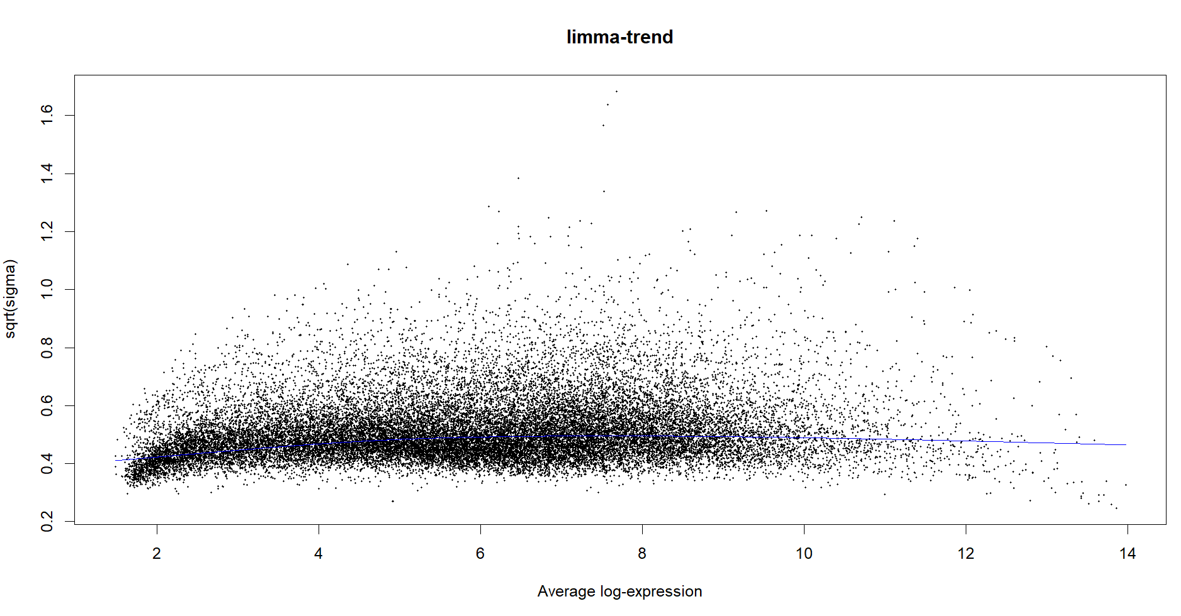
67 Significantly DE Genes Identified from Experiment 1
Sample 1:48 ~ T2D, FDR< 0.05
 | Non-Obese | Obese
Healthy | 32 | 0
T2D | 8 | 2

Slide 14
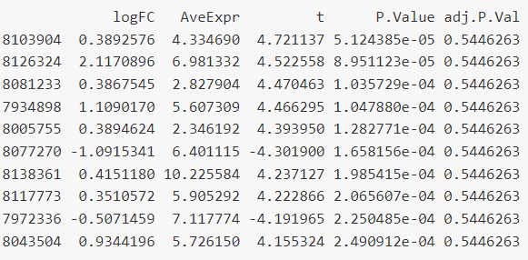
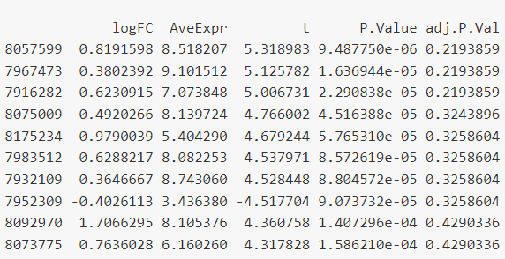
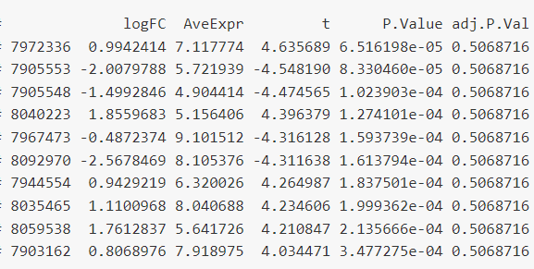
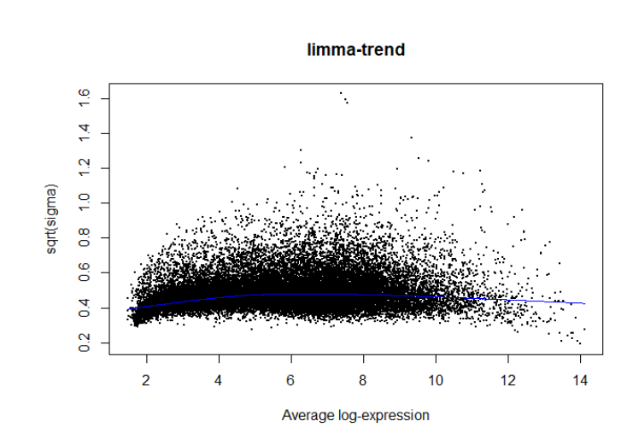
No Significantly DE Identified under the Interactive Model for Experiment Two
T2D
Sample 49 to 77 ~ T2D*BMI, FDR< 0.05
BMI
 | Non-Obese | Obese
Healthy | 15 | 4
T2D | 6 | 4
T2D:BMI

Slide 15


Results
T2D is associated with differential gene expression shown by the 67 genes
Cannot reject second half of the null hypothesis: BMI is not associated with differential gene expression. Obesity or not does not seem to affect differential gene expression in T2D individuals

Slide 16
What are the Pathways Associated with T2D vs Healthy? How do they Contribute to Other Health Complications?
Notes:
Based on the DE gene obtained from comparing between T2D patients and healthy control, we performed functional analysis to investigate how these genes are involved in mechanisms of T2D and further investigated the relationship between T2D and other diseases.

Slide 17
Gene Set Enrichment Analysis
Human Molecular Signatures Database (MSigDB):
Reactome
Biological processes, entities (e.g., nucleic acids, proteins) participating in reactions
Pathway Interaction Database (PID)
Signaling pathways, molecular interactions, and cellular locations of signaling molecules
ImmmuneSigDB
immune cell types, immune-related pathways, and gene expression signatures related to immune system
Kyoto Encyclopedia of Genes and Genomes (KEGG)
Biological and disease pathways, and interactions between molecules
DisGeNET
Association between genetic variants and diseases
Rank-based GSEA
Notes:
We then carried out Gene Set Enrichment analysis with the Human Molecular Signatures Database for GSEA as it is comprehensive, containing a standardized and curated set of gene sets
KEGG pathway (https://www.pathway.jp/) - Like REACTOME, the KEGG database also provides information on various biological pathways for multiple species, but it also provides information on the interactions between genes, proteins, and small molecules.
Reactome (https://reactome.org/what-is-reactome#:~:text=Reactome%20is%20used%20by%20clinicians,building%20predictive%20models%20of%20normal) - And we used the REACTOME database. Reactome is a curated pathway database that covers a wide range of biological processes, including metabolism, signaling, and gene expression, and has been used in numerous studies to identify biologically relevant pathways associated with various diseases and conditions. Reactome tends to focus on nucleic acids, proteins, complexes, vaccines, anti-cancer therapeutics and small molecules participating in reactions. So this pathway database tends to focus on the molecular mechanisms of differentially expressed genes.
ImmuneSigDB:

Slide 18
Result - Reactome
fgsea analysis: A total of 82 (out of 1654) significant pathways are identified (p.adjust <0.05)
Immune system
Inflammatory responses
Signaling
Cellular processes
Cancer & Disease (also can be considered as abnormal cellular processes)
Notes:
pathways are involved in a variety of cellular processes including metabolism of RNA, protein phosphorylation cascades, cytokine signaling in the immune system, hemostasis, mRNA splicing, and modifications to ribosomal RNA (rRNA). Several of the pathways are associated with diseases or abnormal cellular processes such as cancers and diseases associated with glycosaminoglycan metabolism.

Slide 19
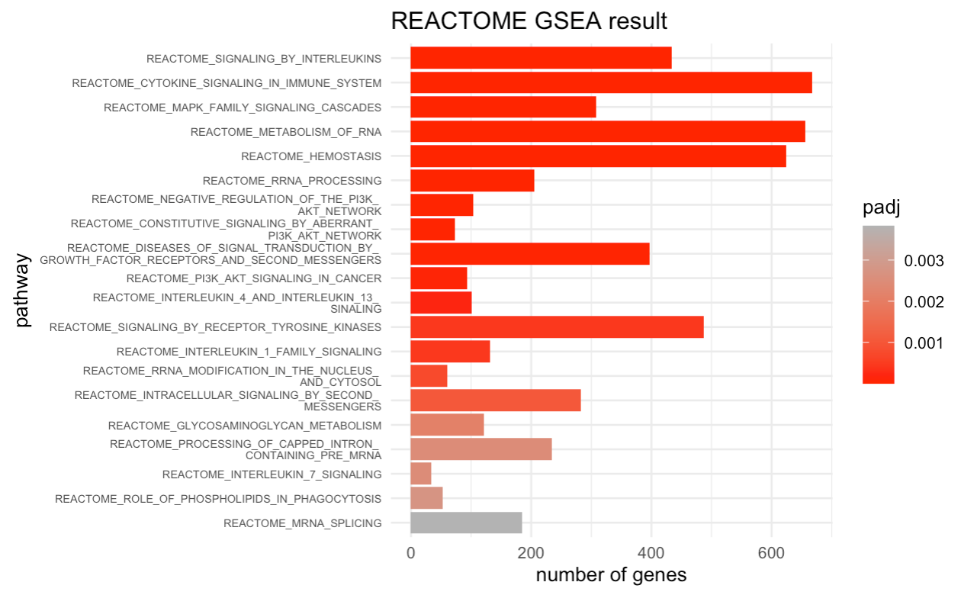
Result - Reactome
So many pathways related to signaling and immune system!
Notes:
Note the black arrows are related to the PI3K signaling and they are involved in insulin signaling and glucose metabolism, making it an important pathway in the development of type 2 diabetes (T2D). Dysregulation of PI3K signaling has been implicated in insulin resistance, a key pathogenic factor in the development of T2D. Insulin resistance leads to decreased glucose uptake in peripheral tissues such as muscle and adipose tissue, resulting in increased glucose levels in the blood. In addition, alterations in PI3K signaling can lead to impaired insulin secretion by pancreatic beta cells, contributing to the development of T2D. Thus, PI3K signaling is an important pathway to study in the context of T2D.
Red arrows: interleukins and cytokine related pathways. Interleukins are a group of signaling molecules that are involved in the regulation of the immune system and inflammation. T2D is a chronic disease that is associated with chronic low-grade inflammation and dysfunction of the immune system. Several studies have suggested that dysregulation of interleukin signaling can contribute to the development and progression of T2D.
So many significant pathways associated with T2D are related to immune system, so we specifically looked at the immunologic signature gene sets from the MsigDB.

Slide 20
PID - Result
fgsea analysis: a total of 25 (out of 196) pathways are identified (p.adj<0.05)
Cellular processes (e.g., cell proliferation or cell migration)
Immune system
Notes:
These pathways are related to various biological processes, signaling pathways, and cellular events.

Slide 21
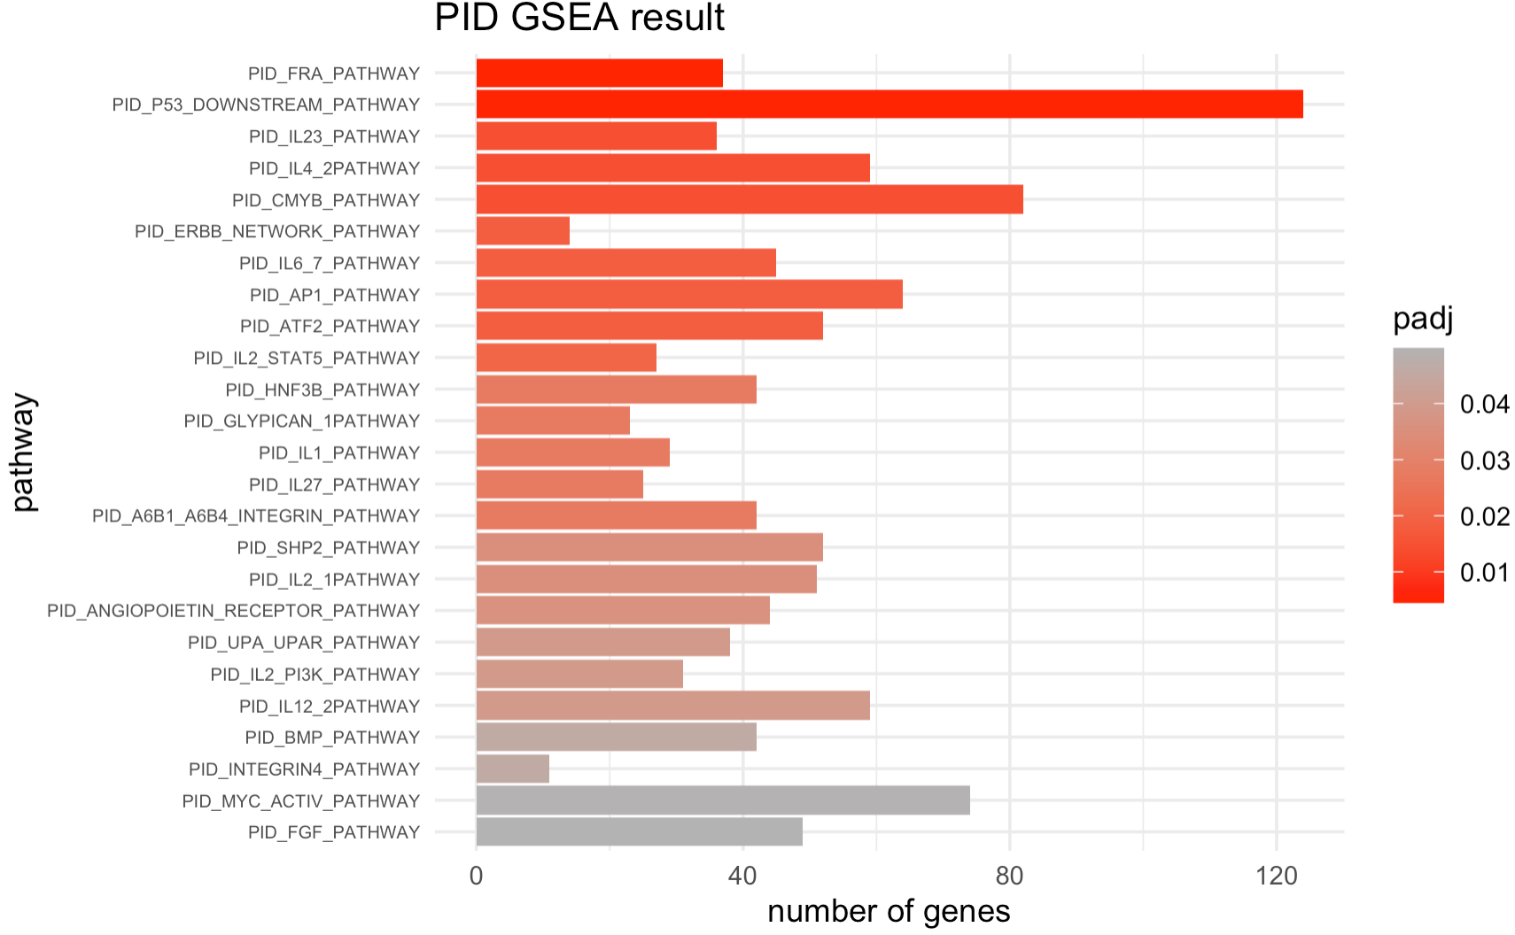
PID - Result
Notes:
One thing worth paying attention to: so many pathways are related to immune system.

Slide 22
Result - ImmuneSigDB
fgsea analysis: A total of 1970 (out of 4872) significant pathways are identified (p.adjust <0.05)

Slide 23
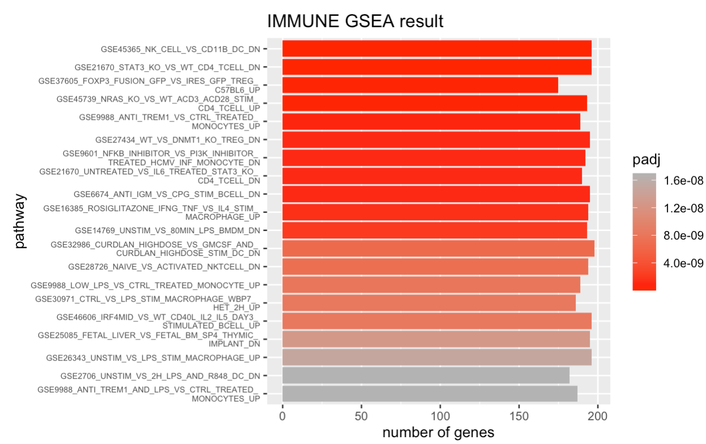
Result - ImmuneSigDB
Notes:
Note: We are only graphing the top 20 significant pathways.
GSE45365_NK_CELL_VS_CD11B_DC_DN: compare the dendritic cells and natural killer (NK) cells expression level.
GSE21670_STAT3_KO_VS_WT_CD4_TCELL_DN: significant downregulation of genes related to the CD4 T-cell pathway in STAT3 knockout samples compared to wildtype samples. STAT3 is a transcription factor that plays a key role in the development and function of immune cells, including CD4 T-cells. The downregulation of genes related to the CD4 T-cell pathway in STAT3 knockout samples may suggest impaired immune function, which could potentially contribute to the development of diseases such as T2D. However, further analysis and validation would be necessary to confirm this hypothesis.
GSE37605_FOXP3_FUSION_GFP_VS_IRES_GFP_TREG_ \n C57BL6_UP: an upregulation of genes related to regulatory T cells (Tregs) that express FOXP3 (Forkhead box P3), a transcription factor that is highly expressed in Tregs and plays a critical role in their development and function. The pathway comparison involves two types of Tregs, one expressing a fusion protein of FOXP3 and GFP (green fluorescent protein) and the other expressing only GFP, in a mouse model (C57BL/6 strain). The upregulation of genes related to Tregs suggests an increased presence and activity of these cells in the FOXP3-expressing Treg population compared to the GFP-only Treg population. Overall, this pathway may indicate the involvement of Tregs and FOXP3 in the immune response or disease process being studied.
GSE45739_NRAS_KO_VS_WT_ACD3_ACD28_STIM_ \n CD4_TCELL_UP: a significant upregulation of genes involved in CD4 T cell activation and proliferation in cells where the NRAS gene is knocked out compared to wildtype cells under conditions of CD3 and CD28 stimulation. This may suggest a potential role for NRAS in regulating T cell activation and proliferation.

Slide 24
Result - KEGG
fgsea analysis: 34 pathways are identified as significant (FDR<0.05)
Signaling pathways
Metabolism
Immune system/Pathogen infection
Disease pathways
Notes:
Why we choose what we choose

Slide 25
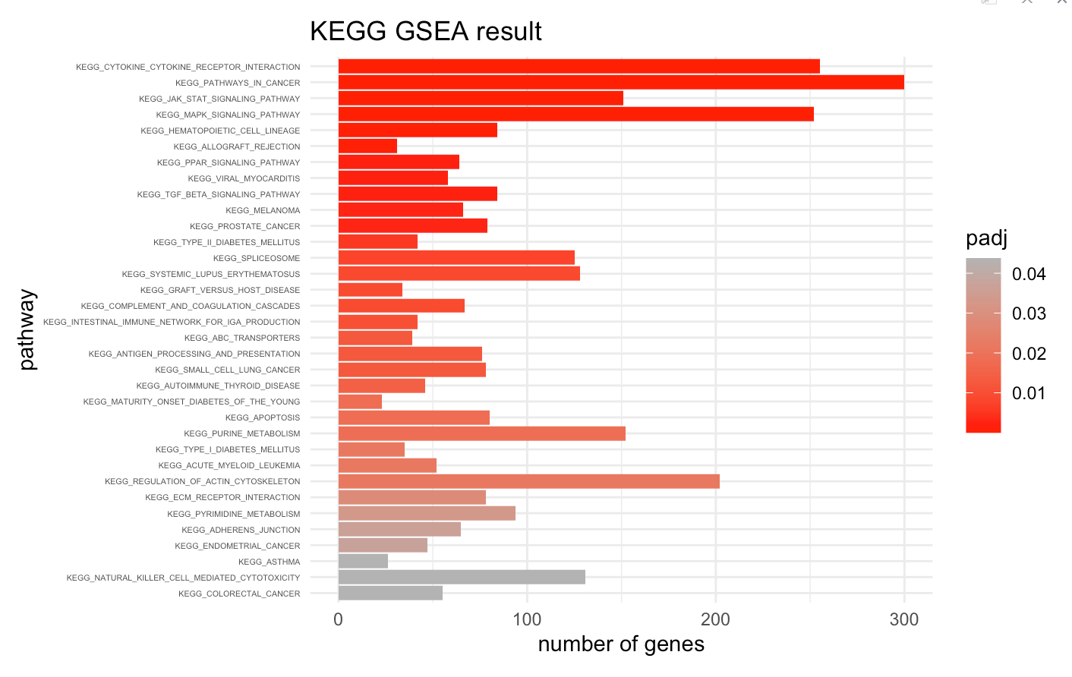
Result - KEGG

Slide 26
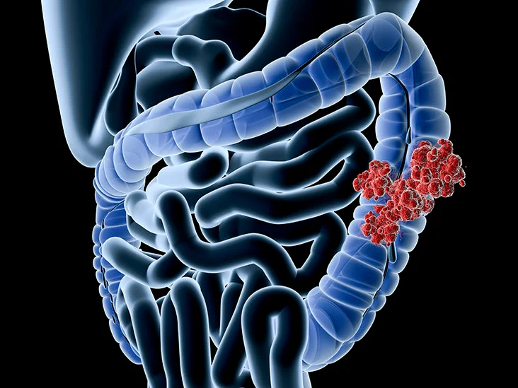
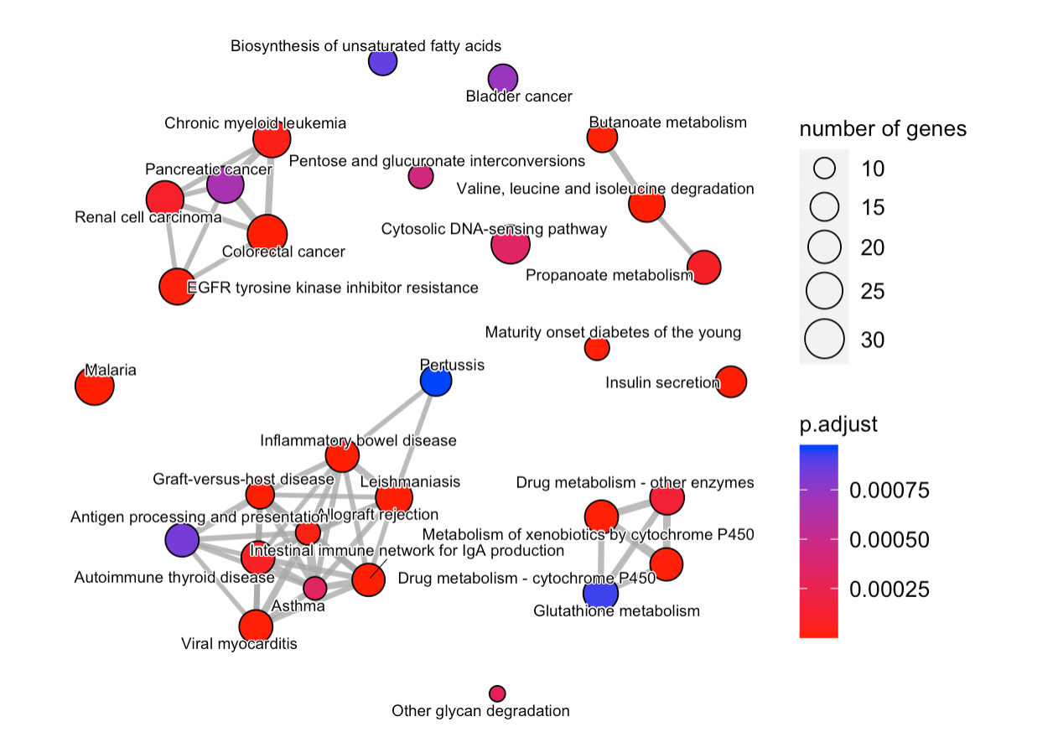
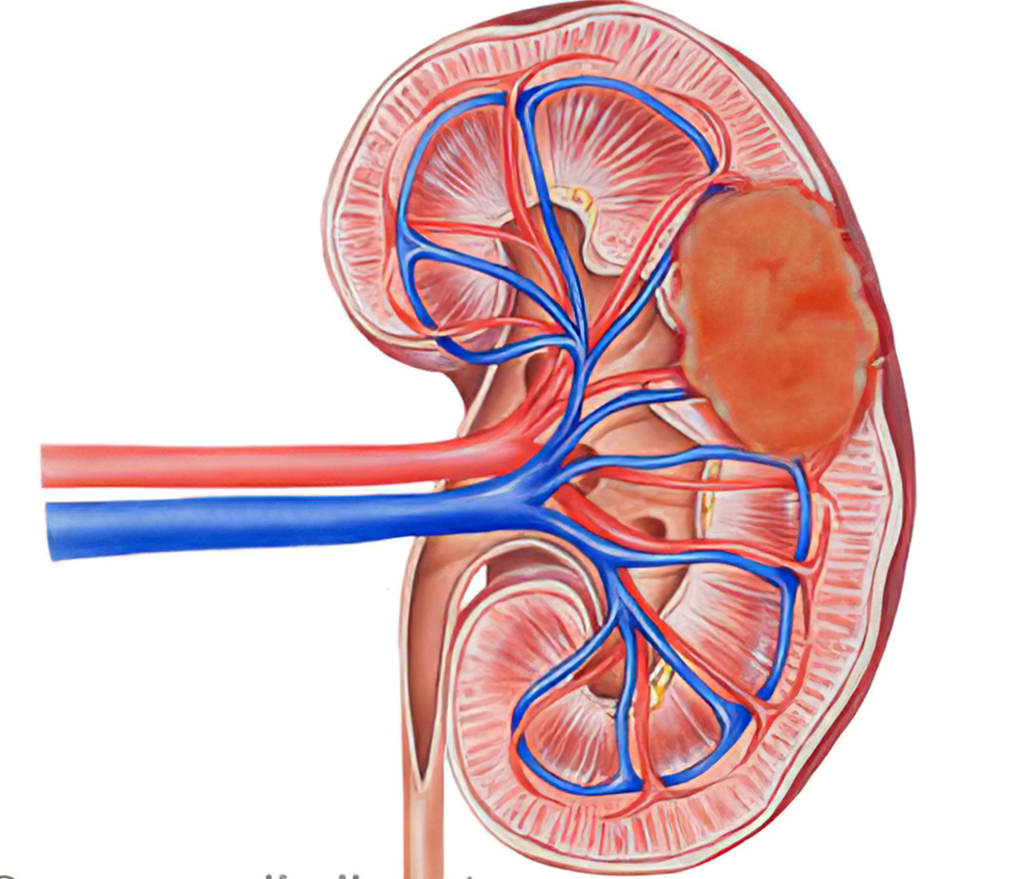
KEGG Enrichment Map
TCF7L2 gene
MAPK signaling pathway
TFG beta signaling pathway
PIK3 pathway
MAPK signaling pathway
JAK-STAT pathway

Slide 27
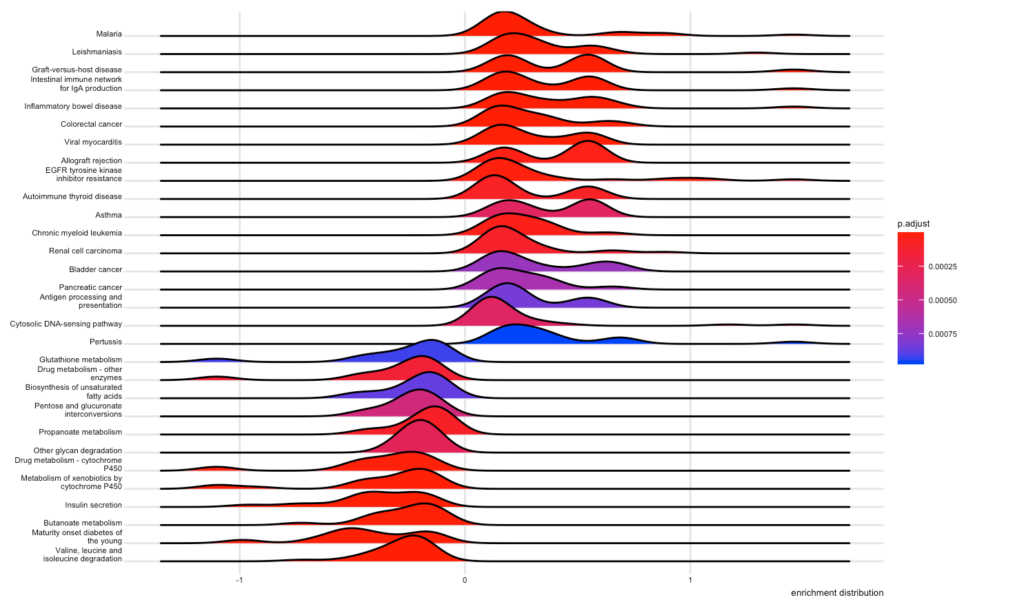
KEGG Ridge Plot

Slide 28
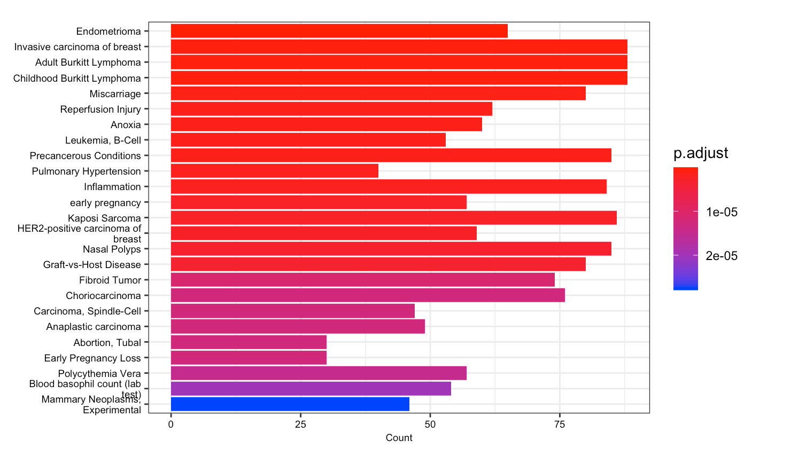
Disease Association with T2D - DisGeNET
Insert image

Slide 29
Conclusions
T2D status is associated with differential gene expression
Overall, more than 100 pathways associated with T2D
Many immune pathways
Many metabolic pathways are down-regulated and disease pathways are up-regulated
T2D has an association with many diseases
renal cell carcinoma and colorectal cancer share many biological pathways
There might be a stronger effect of T2D on female patients

Slide 30
Limitations
Linear Regression
Limitation of microarray data
Unbalanced and small samples
Relationship between gene expression and phenotype
Gene Set Enrichment Analysis
One bias; Large number of immune pathways?

Slide 31
Future Directions
A study with larger sample size to analyze the effect of BMI on gene expression for T2D patients
GO GSEA
But be cautious with the hierarchical relationships
Look into the drug-gene network for the potential discovery of therapeutic target sites

Slide 32
Thanks for Listening!
Q&A

